Slide 1

Iterative Data Processing with Deep Transfer Learning
Tonja Jean

Slide 2
CONTENTS
1.
Introduction
2.
Deep Learning to Deep Transfer Learning
3.
About “Deep Transfer Learning for Kidney Cancer Diagnosis”
4.
Advantages of Deep Transfer Learning
5.
Conclusion

Slide 3
1
Introduction
Notes:
Deep Transfer Learning in data science refers to the process of applying knowledge gained from one domain or task to improve performance on a different, but related, domain or task. This is particularly useful when there is a lack of labeled data in the target domain, allowing models to leverage learned representations from a larger, labeled dataset in a similar source domain.

Slide 4

Deep Transfer Learning Definition(DTL)
Applying Knowledge from One Domain to Another
Improves performance on related, but different tasks.
01
Useful in scenarios with limited labeled data in the target domain.
02
Leverages representations from larger, labeled datasets in similar source domains.
03

Slide 5
2
Deep Learning to Deep Transfer Learning

Slide 6
Deep Learning
Features and Applications
01
02
03
Uses neural networks with multiple layers to learn data representations. (hence "deep") Models are trained from scratch on large, labeled datasets.
Can automatically learn complex patterns and hierarchies.
Applied in tasks like image recognition, language processing, and speech analysis.
Notes:
Deep learning is a branch of machine learning focused on using neural networks with multiple layers (hence "deep") to learn representations of data. These networks can automatically learn complex patterns and hierarchies within the data, making them powerful for tasks like image recognition, language processing, and speech analysis.
In deep learning, models are typically trained from scratch on large, labeled datasets. The goal is to optimize the model for a specific task within a single domain.

Slide 7



Deep Transfer Learning(DTL)
Extending Deep Learning
Transfers knowledge from a deep learning model trained on one domain to another domain.
Uses models pre- trained on large datasets and adapts them for new tasks.
Aims to improve performance in settings with different data distributions or limited labeled data.
Notes:
Deep Transfer Learning (DTL) is an extension of deep learning that leverages the representations learned by a deep learning model trained on one domain (the source domain) and applies it to another domain (the target domain).
In DTL, a deep model is usually pre-trained on a large, general dataset (e.g., ImageNet for images) and then adapted (or fine-tuned) for a new, potentially related task, often with limited data in the target domain.
The key idea behind DTL is to transfer knowledge learned by a deep network in one setting to improve performance in another setting, which may have a different data distribution or a limited amount of labeled data.

Slide 8
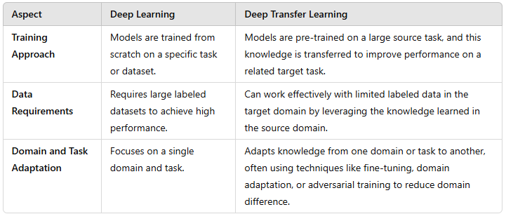
Deep Learning to Deep Transfer Learning(DTL) Comparison
Notes:
Deep Transfer Learning (DTL) is an extension of deep learning that leverages the representations learned by a deep learning model trained on one domain (the source domain) and applies it to another domain (the target domain).
In DTL, a deep model is usually pre-trained on a large, general dataset (e.g., ImageNet for images) and then adapted (or fine-tuned) for a new, potentially related task, often with limited data in the target domain.
The key idea behind DTL is to transfer knowledge learned by a deep network in one setting to improve performance in another setting, which may have a different data distribution or a limited amount of labeled data.

Slide 9
3
About “Deep Transfer Learning for Kidney Cancer Diagnosis”
Notes:
In the article "Deep Transfer Learning for Kidney Cancer Diagnosis," the distinction between Deep Transfer Learning (DTL) and Transfer Learning (TL) centers around the use of deep learning architectures in DTL, which provides several key advantages over traditional TL methods.

Slide 10
Key Comparisons with Traditional Transfer Learning
Hierarchical Feature Learning
Utilizes deep neural networks to automatically learn hierarchical data representations. Captures intricate patterns relevant to kidney cancer diagnosis. Traditional TL relies on manually engineered features or shallow models.
Higher Performance on Complex Data
Handles complex, high- dimensional data like medical imaging effectively. Recognizes subtle variations crucial in early- stage cancer detection. Standard TL methods struggle with high- dimensional data.
Increased Adaptability for Medical Imaging
Generalizes effectively across different imaging modalities and protocols. Fine- tuning layers of a pre- trained model adapts well to healthcare tasks. Traditional TL lacks the flexibility and multiple layers of abstraction.
Notes:
Hierarchical Feature Learning:
Deep Transfer Learning leverages deep neural networks, which automatically learn hierarchical representations of data (from simple to complex features). This ability allows DTL to capture intricate patterns in medical images, such as textures and shapes relevant to kidney cancer diagnosis.
In contrast, traditional TL approaches may rely on manually engineered features or shallow models, which lack the same depth of representation and may miss complex image characteristics important for accurate diagnosis.
Hierarchical clustering works by first putting each data point in their own cluster and then merging clusters based on some rule, until there are only the wanted number of clusters remaining. For this to work, there needs to be a distance measure between the data points. With this distance measure d, we can define another distance measure between the clusters U and V using one of the following methods (linkages):
Higher Performance on Complex Data:
DTL, with its deep neural network architecture, can handle complex, high-dimensional data like medical imaging (MRI, CT scans) more effectively. Deep networks are particularly suited for recognizing subtle variations in medical images, which is crucial in detecting early-stage cancers.
Standard TL methods may struggle with such high-dimensional data, as they are not inherently designed to model complex structures as effectively as deep networks.
Increased Adaptability for Medical Imaging:
DTL provides greater adaptability for various imaging modalities, allowing models to generalize more effectively across different types of medical images and even different imaging devices or protocols. By fine-tuning layers of a deep model pre-trained on a large, general dataset, DTL adapts well to domain-specific tasks in healthcare, like kidney cancer diagnosis.
Traditional TL lacks this flexibility because it often does not have the multiple layers of abstraction that make deep networks effective in transferring learned representations across domains with complex, nuanced data.

Slide 11
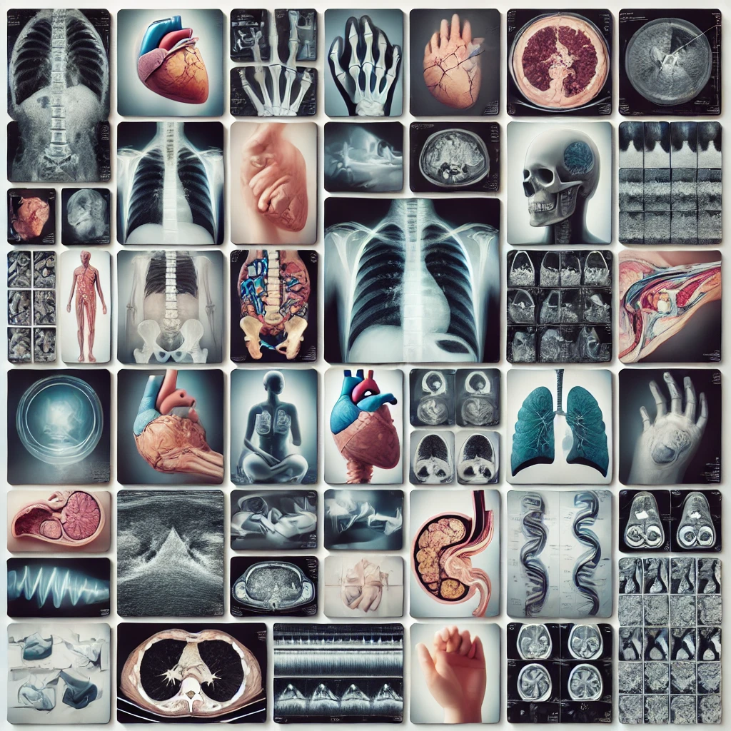



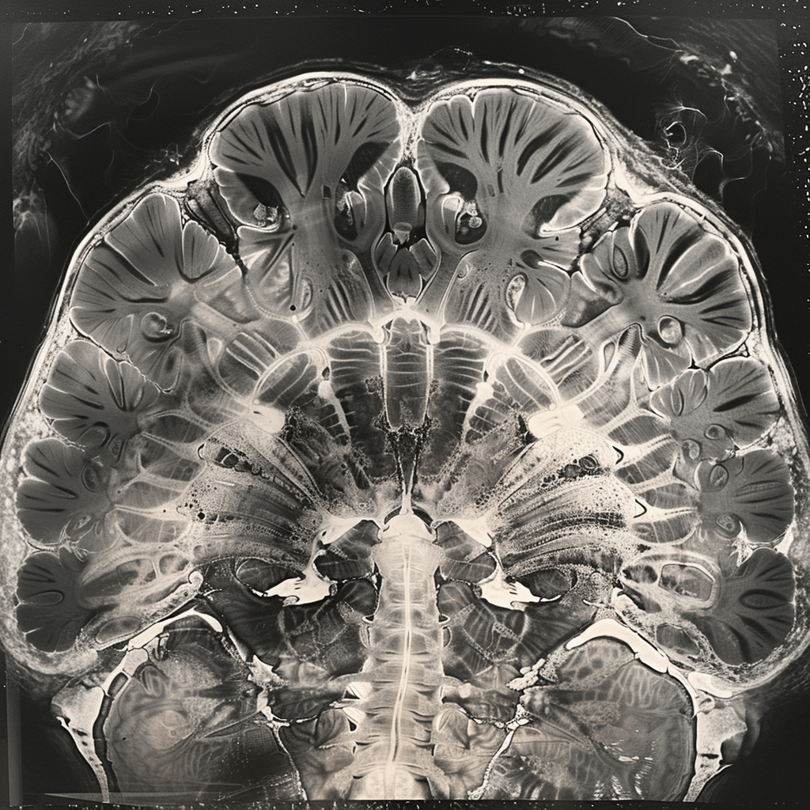

Surveyed Deep Learning Transfer
Deep Learning Architectures
Transfer Learning Frameworks
Uses convolutional neural networks (CNNs) for image recognition tasks. Essential for extracting hierarchical features from complex medical images.
Adapts pre- trained models from general datasets to specialized medical imaging tasks. Techniques include fine- tuning and feature extraction to leverage pre- trained models.
3
Domain Adaptation Techniques
Medical Imaging Technologies
Reduces distributional shifts between source and target domains. Techniques include adversarial domain adaptation, instance reweighting, and Maximum Mean Discrepancy (MMD).
CT scans, MRIs, and ultrasounds as primary data sources. Addresses challenges in processing and analyzing medical images with deep and transfer learning models.
Notes:
This survey in Deep Learning Transfer focused on the following data science technologies.
Deep Learning Architectures:
The article discusses the use of various deep learning models, such as convolutional neural networks (CNNs), which are commonly applied in image recognition tasks, particularly for analyzing medical images like CT and MRI scans.
These architectures are integral to deep transfer learning, as they provide the hierarchical feature extraction needed for complex visual data in medical diagnostics.
Transfer Learning Frameworks:
Transfer learning frameworks are central to the article, specifically how pre-trained models can be adapted from general image datasets (e.g., ImageNet) to medical imaging tasks for kidney cancer diagnosis. Techniques like fine-tuning and feature extraction are highlighted as practical approaches to leverage pre-trained models in a data-scarce medical domain.
Domain Adaptation Techniques:
The article emphasizes domain adaptation methods, which are crucial for handling differences between source and target domains (e.g., general vs. medical images). It covers techniques like adversarial domain adaptation, instance reweighting, and Maximum Mean Discrepancy (MMD) to reduce distributional shifts between domains, enabling more accurate predictions in the target medical domain.
Maximum Mean Discrepancy (MMD) is a statistical measure used to compare two probability distributions by evaluating the difference in their means when mapped into a high-dimensional reproducing kernel Hilbert space (RKHS). It is widely used in machine learning for tasks such as distribution comparison, generative model evaluation, and domain adaptation.
Medical Imaging Technologies:
Various imaging modalities, including CT scans, MRI, and ultrasound, are discussed as primary sources of data for kidney cancer diagnosis. The article addresses the unique challenges and requirements of processing and analyzing these medical images using transfer learning and deep learning models.
These technologies are combined to create effective diagnostic tools for kidney cancer, leveraging deep transfer learning to address the challenges of limited data availability and domain-specific complexities in medical imaging.

Slide 12
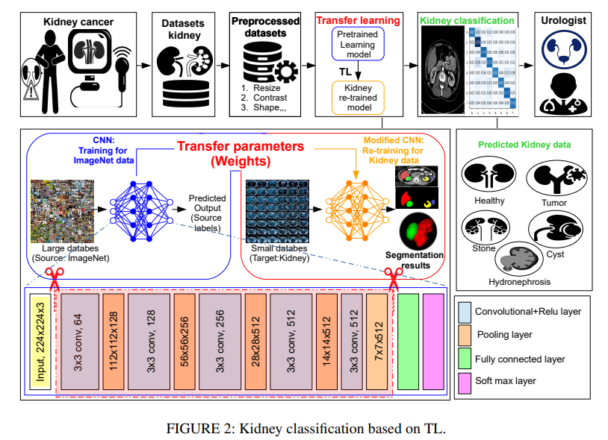
Surveyed Deep Learning Transfer
Photo of [Figure 2: Kidney classification based on TL], Deep Transfer Learning for Kidney Cancer Diagnosis by Yassine Habchi, Hamza Kheddar, Yassine Himeur, Abdelkrim Boukabou, Shadi Atalla, Wathiq Mansoor, Hussain Al-Ahmad vol 4, p 4 2016 https://arxiv.org/abs/2408.04318
Notes:
This survey in Deep Learning Transfer focused on the following data science technologies.
Deep Learning Architectures:
The article discusses the use of various deep learning models, such as convolutional neural networks (CNNs), which are commonly applied in image recognition tasks, particularly for analyzing medical images like CT and MRI scans.
These architectures are integral to deep transfer learning, as they provide the hierarchical feature extraction needed for complex visual data in medical diagnostics.
Transfer Learning Frameworks:
Transfer learning frameworks are central to the article, specifically how pre-trained models can be adapted from general image datasets (e.g., ImageNet) to medical imaging tasks for kidney cancer diagnosis. Techniques like fine-tuning and feature extraction are highlighted as practical approaches to leverage pre-trained models in a data-scarce medical domain.
Domain Adaptation Techniques:
The article emphasizes domain adaptation methods, which are crucial for handling differences between source and target domains (e.g., general vs. medical images). It covers techniques like adversarial domain adaptation, instance reweighting, and Maximum Mean Discrepancy (MMD) to reduce distributional shifts between domains, enabling more accurate predictions in the target medical domain.
Medical Imaging Technologies:
Various imaging modalities, including CT scans, MRI, and ultrasound, are discussed as primary sources of data for kidney cancer diagnosis. The article addresses the unique challenges and requirements of processing and analyzing these medical images using transfer learning and deep learning models.
These technologies are combined to create effective diagnostic tools for kidney cancer, leveraging deep transfer learning to address the challenges of limited data availability and domain-specific complexities in medical imaging.

Slide 13
4
Advantages of Deep Transfer Learning

Slide 14
Benefits Overview
Reduced Data Needs
Improved Performance
Enhances accuracy as pre- learned features generalize better in the target domain.
Supports Few-Shot Learning
Performs well with limited labeled data by using knowledge from related datasets.
Enables learning with minimal data, ideal for specialized or high- cost data fields.
STEP 02
STEP 01
STEP 03
STEP 05
STEP 04
Faster and Cost-Effective Training
Requires less training time and computational resources.
Cross-Domain Adaptability
Applies across various domains and modalities with domain adaptation techniques.
Notes:
Reduced Data Needs: Performs well with limited labeled data by leveraging knowledge from a larger, related dataset.
Faster and Cost-Effective Training: Requires less training time and computational resources, making it efficient for resource-constrained environments.
Improved Performance: Enhances accuracy in related tasks, as pre-learned features help generalize better in the target domain.
Cross-Domain Adaptability: Works across various domains and modalities (e.g., images, text) with domain adaptation techniques.
Supports Few-Shot Learning: Enables learning with minimal data, making it ideal for specialized or high-cost data fields.
As a result, deep transfer learning is an efficient, versatile approach that boosts performance and reduces costs, especially in data-limited scenarios.

Slide 15
5
Conclusion

Slide 16
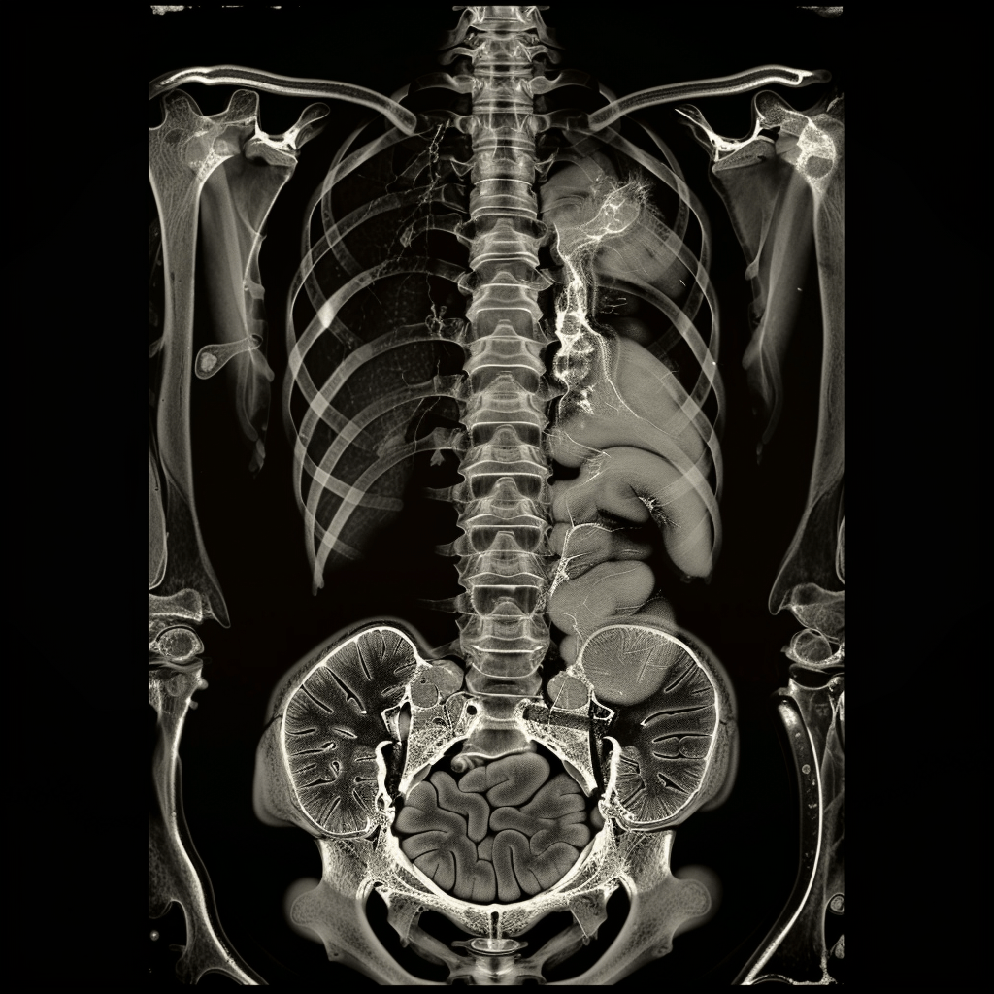
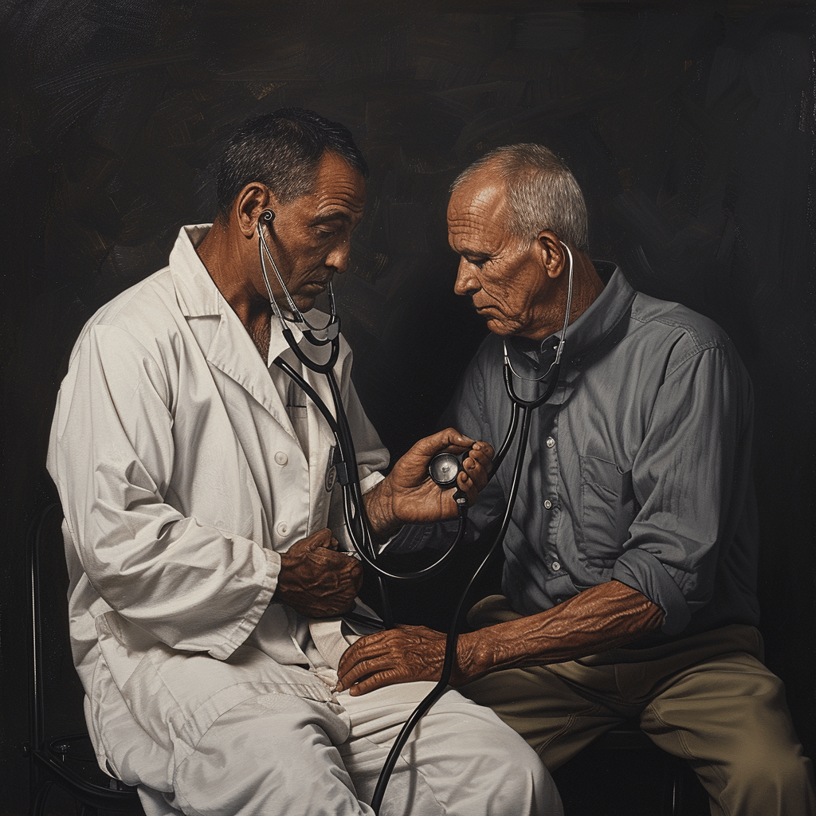
Summary
Efficacy in Medical Imaging
Deep Transfer Learning handles complexity, variability, and high dimensionality in medical imaging.
Leads to improved accuracy and adaptability in kidney cancer diagnosis and clinical applications.
Notes:
In summary, the article emphasizes that Deep Transfer Learning is better suited than traditional TL for handling the complexity, variability, and high dimensionality of medical imaging data in kidney cancer diagnosis, leading to improved accuracy and adaptability in clinical applications.

Slide 17
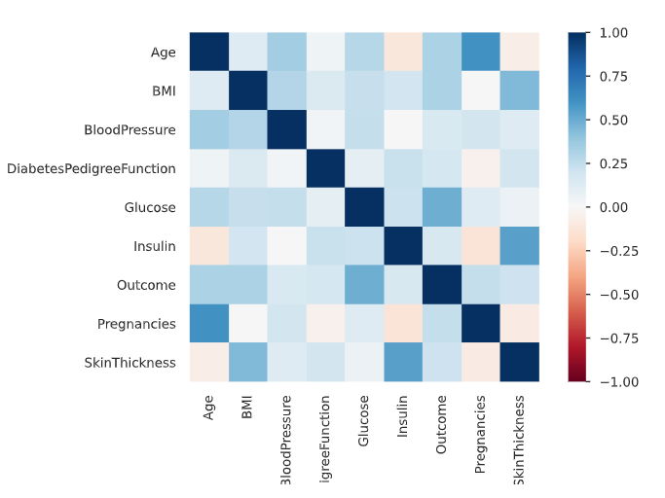
Thanks for your attention
Tonja Jean

